Slide 1
Notes LS2102 Diffusion in Biology Refer to the Class Recording for Discussion Details
LS2102 (Autumn 2020)
IISER Kolkata
17-11-20
19-11-20

Slide 2
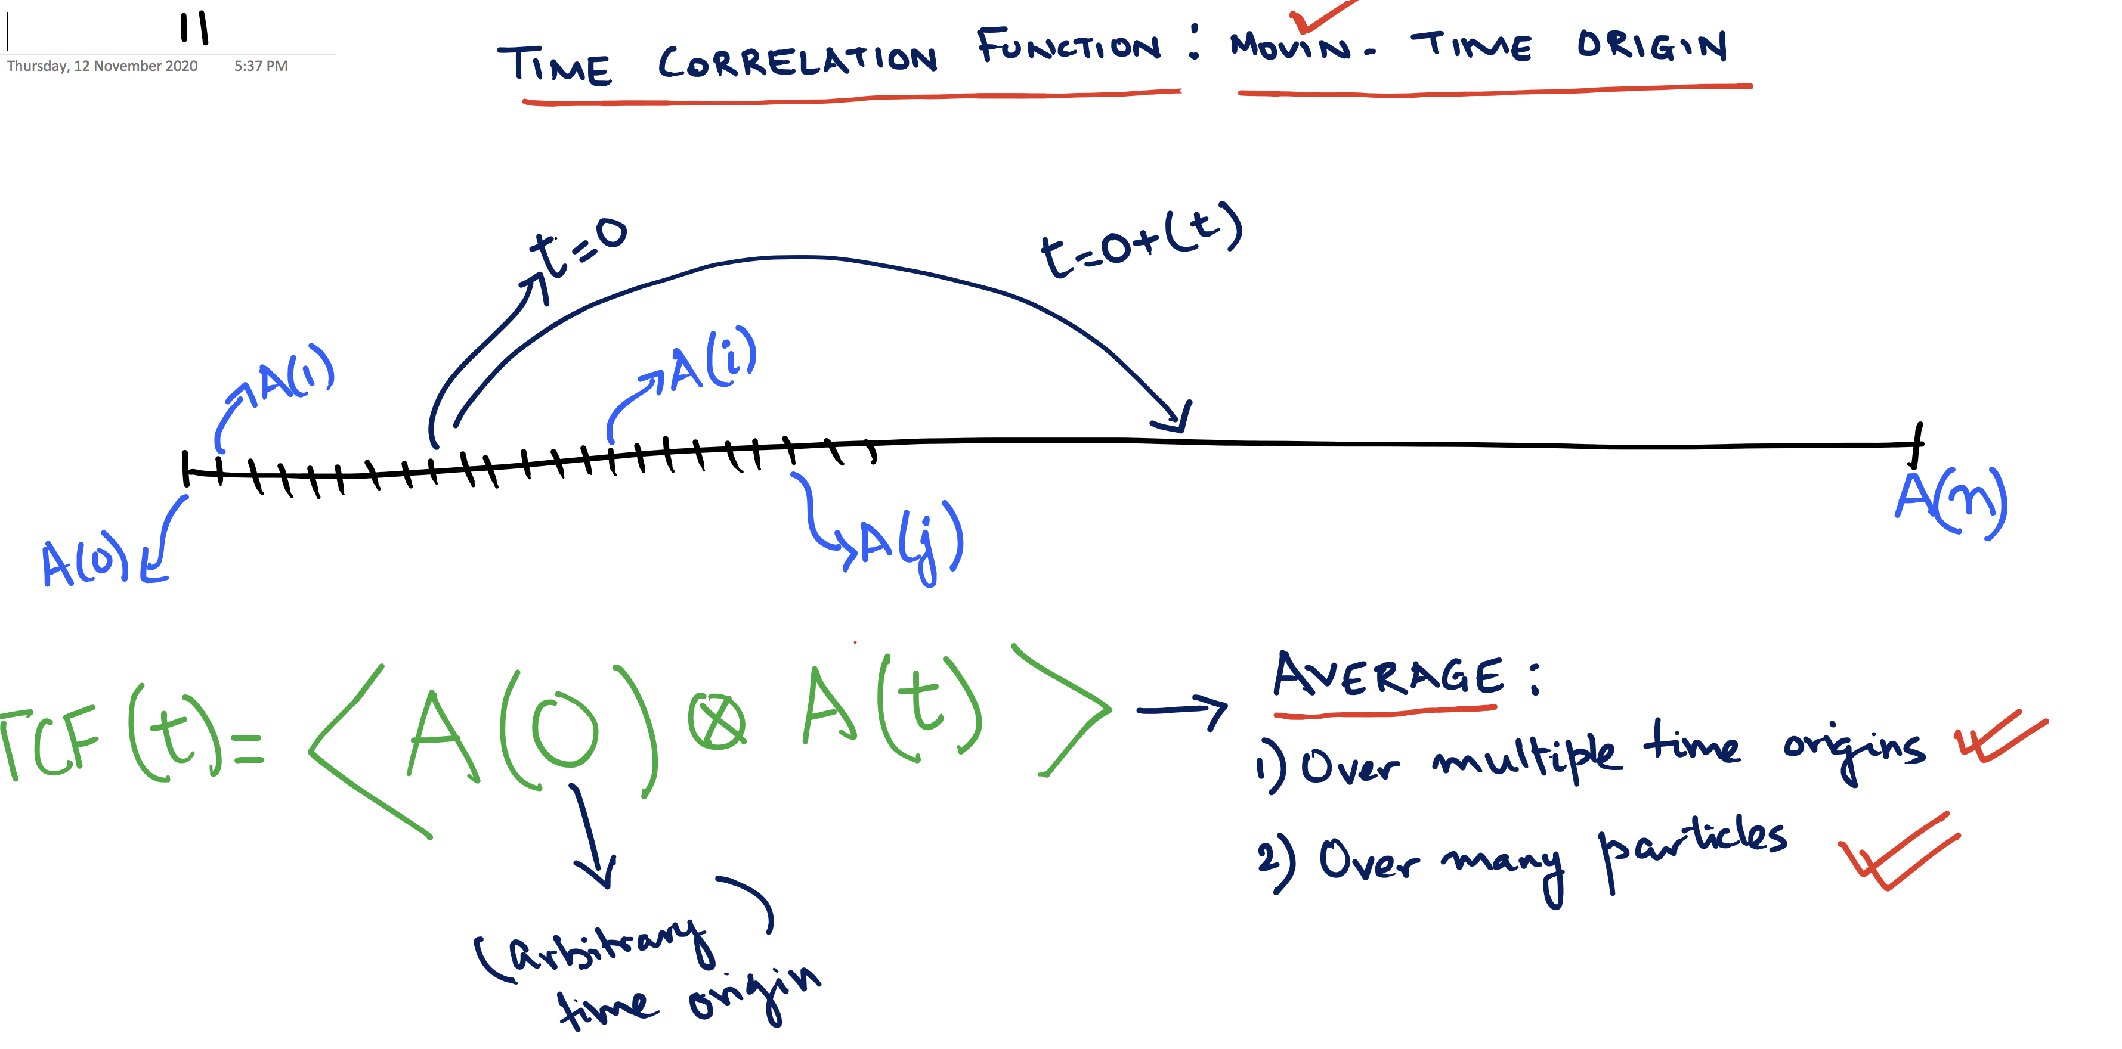

Slide 3
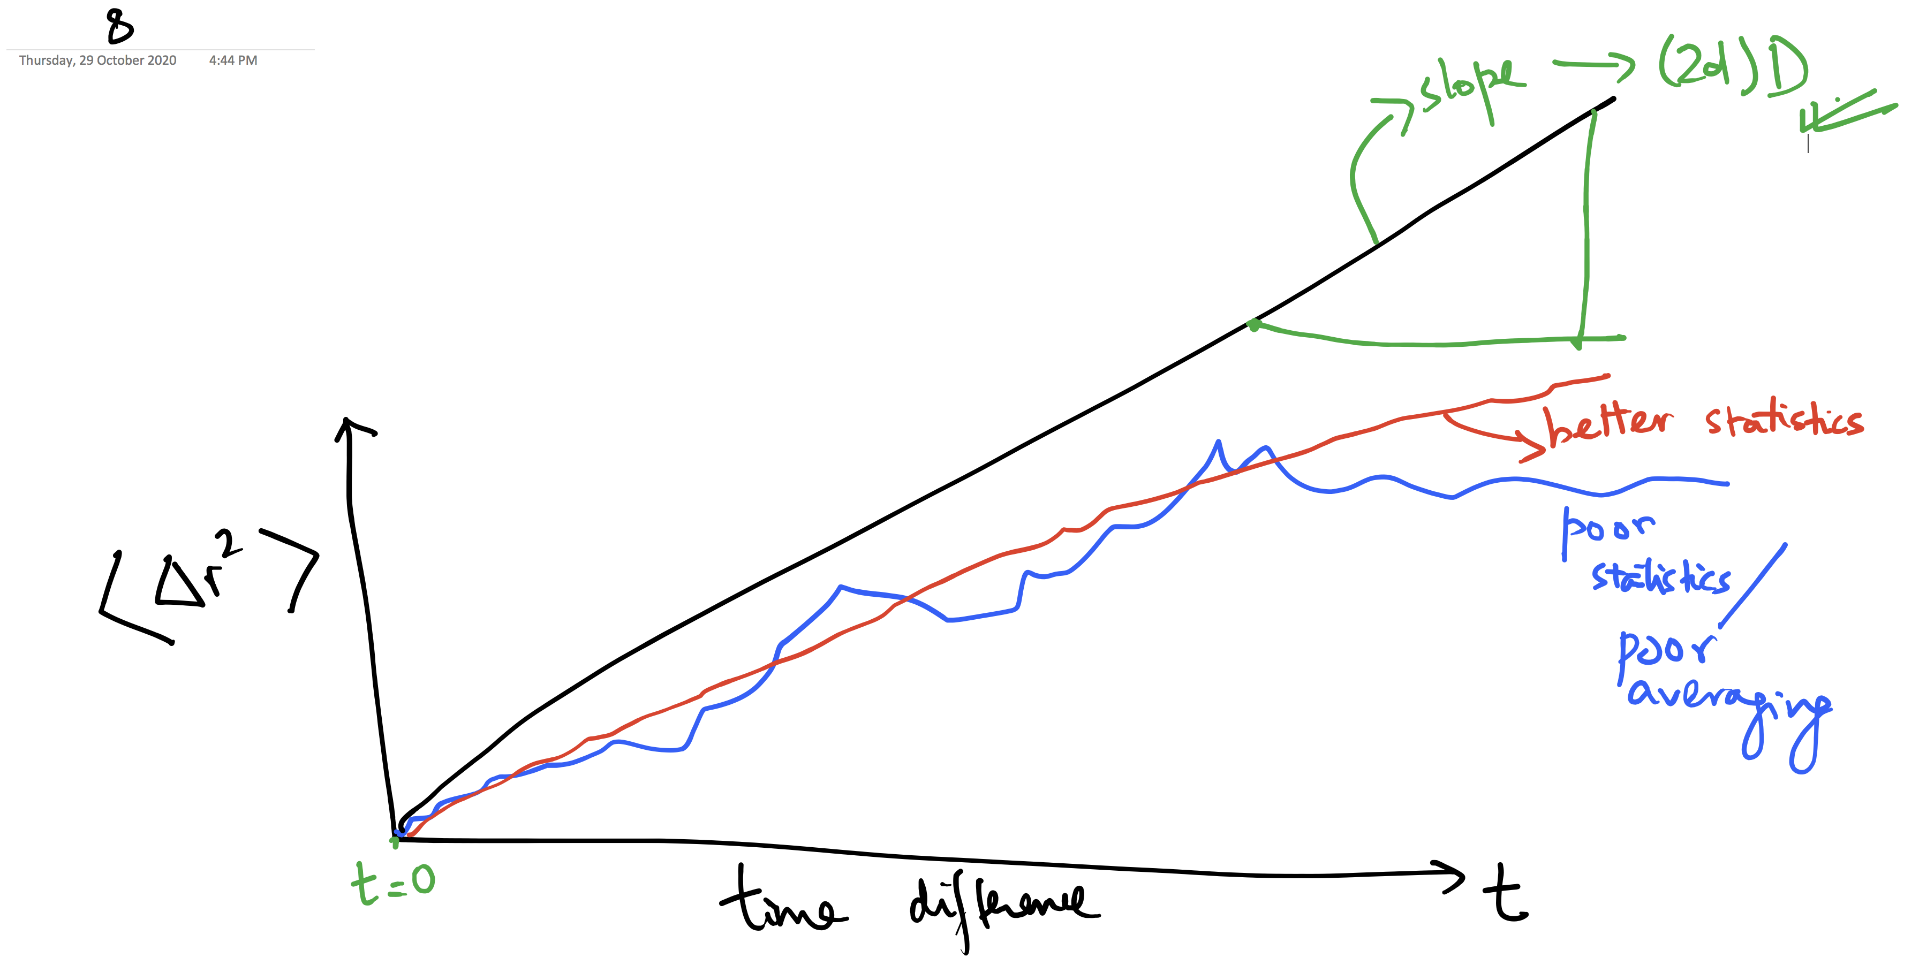

Slide 4
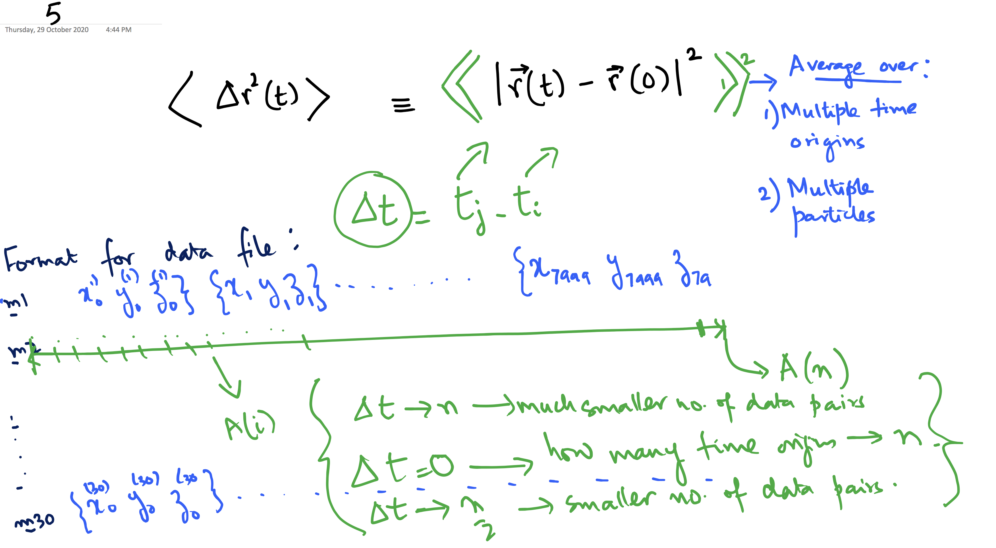

Slide 5
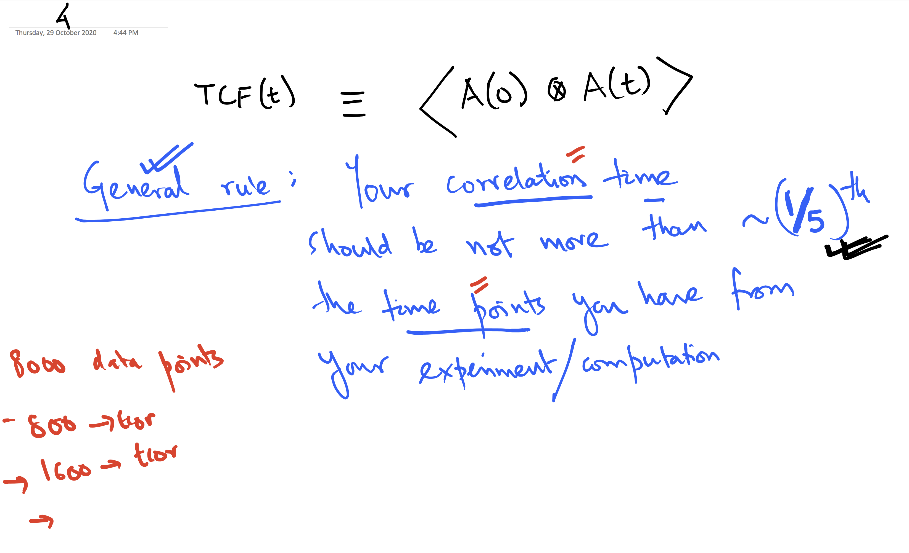

Slide 6
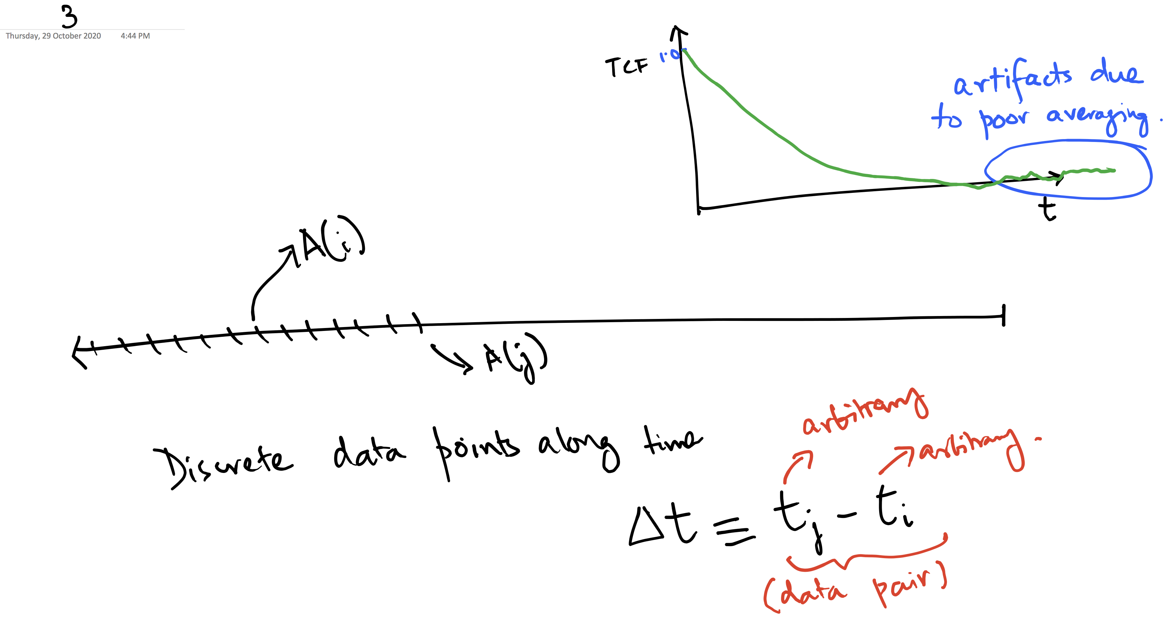

Slide 7
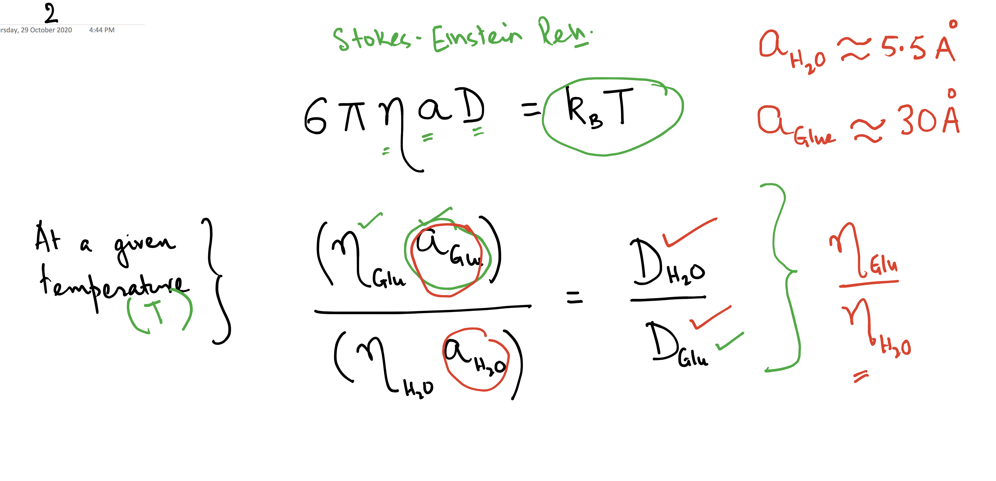

Slide 8
